Slide 1
2012
Phlas Prei Centre
Notes:
2012
Phlas Prei Centre

Slide 2
Thailand
2013
House Build in Chiang Mai
Notes:
2013

Slide 3
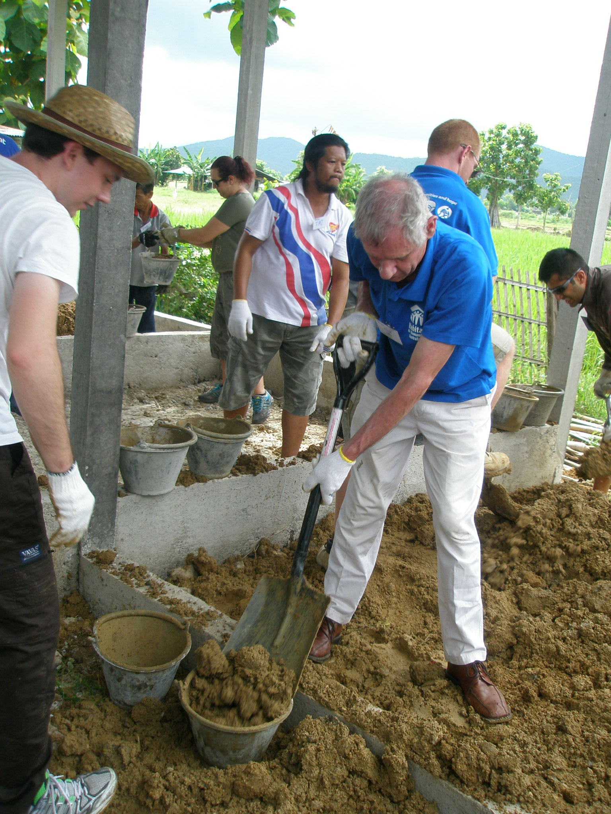
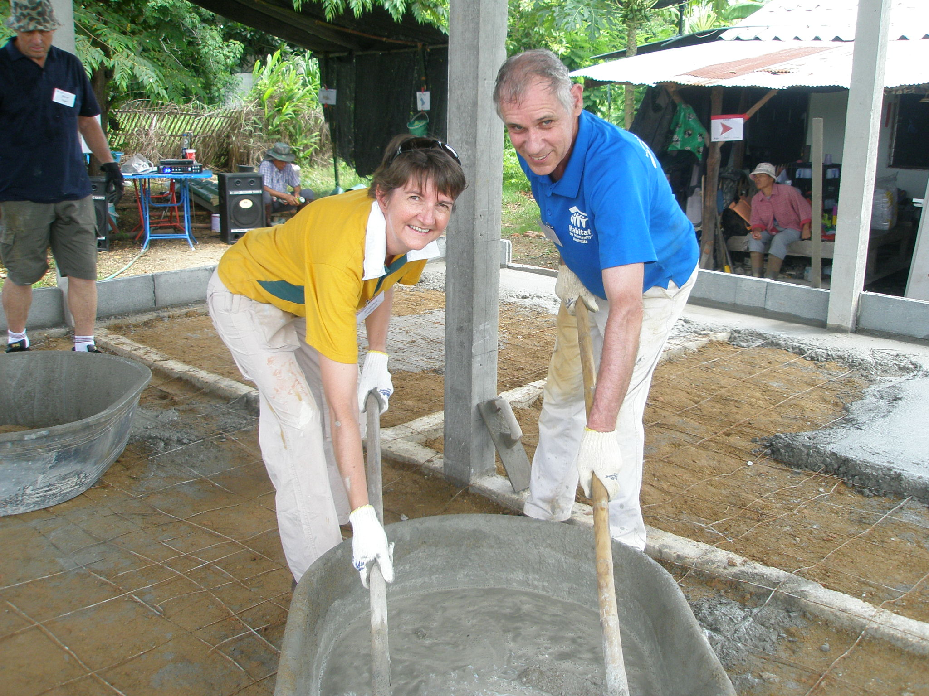
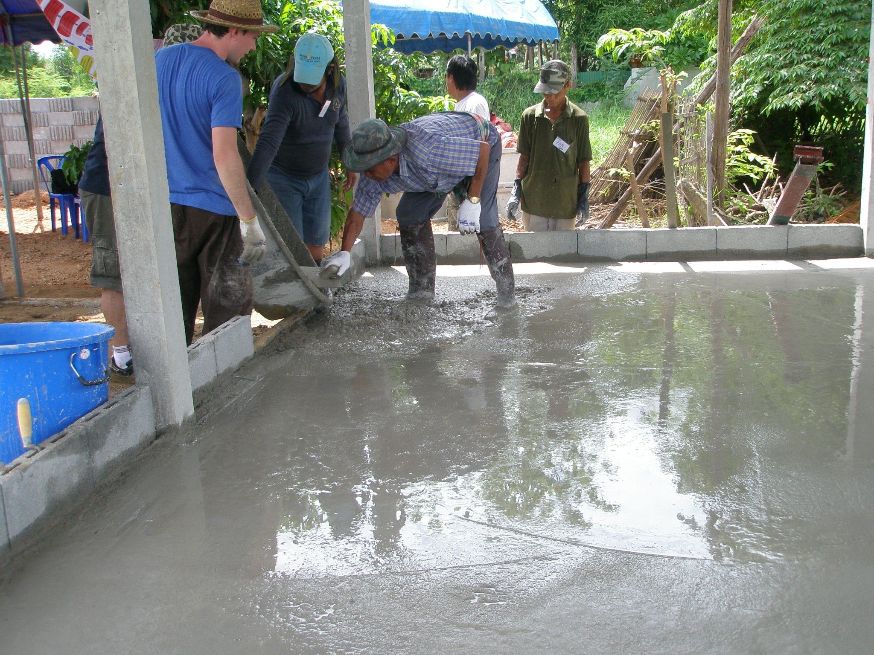
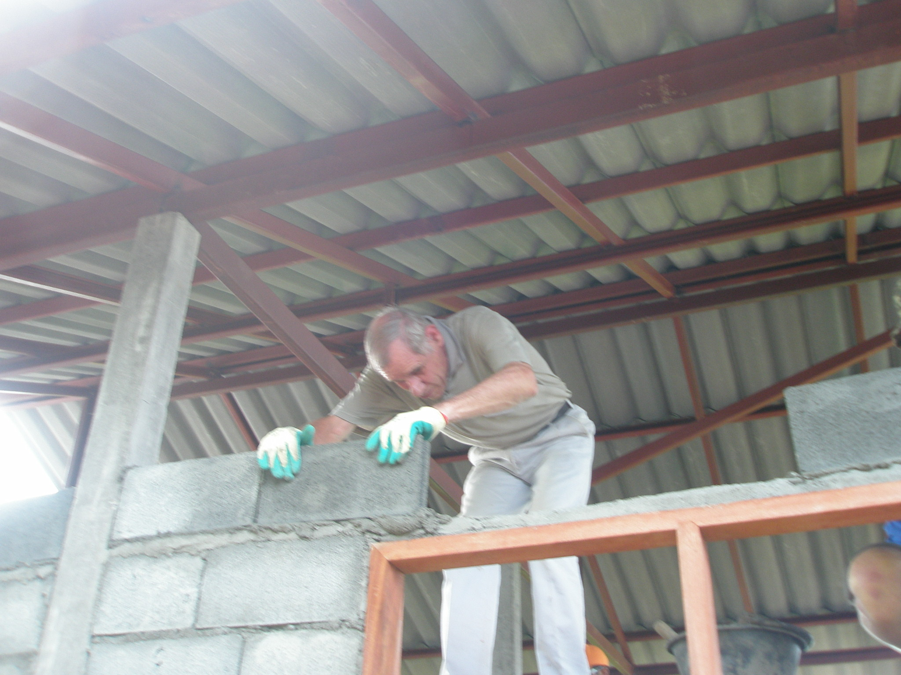
Foundation, Floor & Bricklaying
Notes:
Foundations & Bricklaying

Slide 4
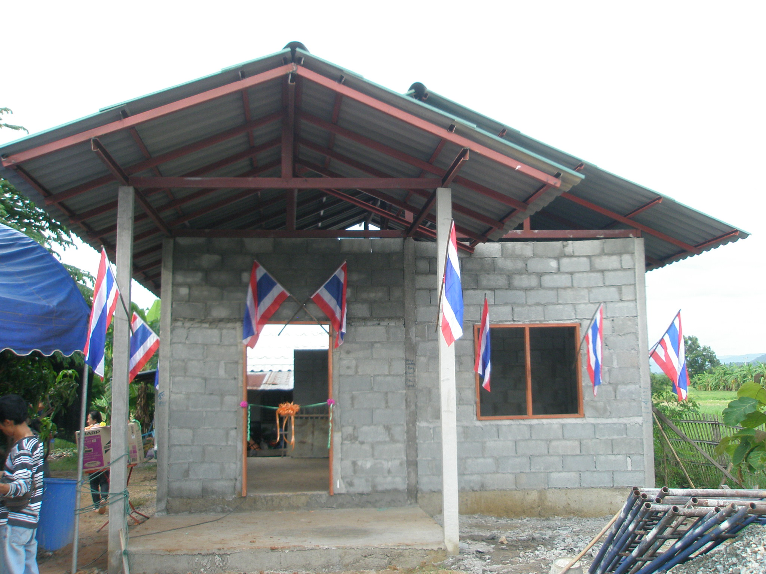
Near Finished
Notes:
Near Finished

Slide 5
Cambodia / Thailand
2014
Over 1,400 Children Rescued since 2011
Notes:
Over 1
2014 400 Children Rescued since 2011

Slide 6
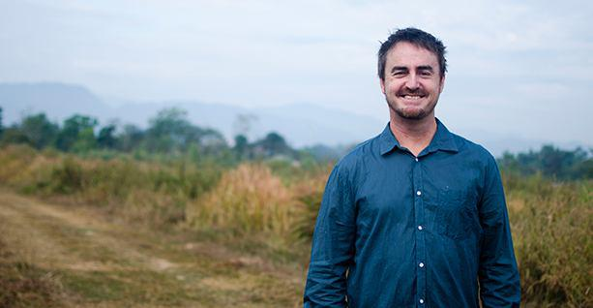
Tony Kirwan
Founded Destiny Rescue in 2001
Operate in 5 Countries – Thailand, Cambodia, Laos, Philippines & India
Notes:
Operate in 5 Countries – Thailand, Cambodia, Laos, Philippines & India

Slide 7
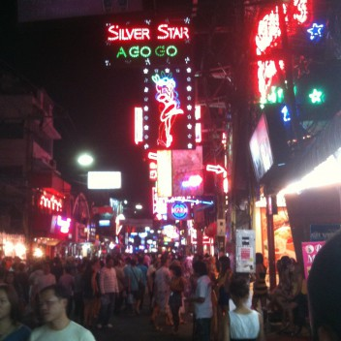
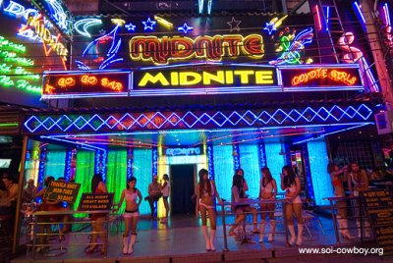
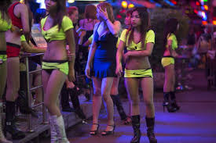
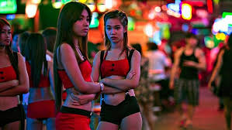
Red Light District in Bangkok
1,600 Children Rescued in last 5 years
Notes:
Red Light District in Bangkok
1,400 Children Rescued since 2014

Slide 8
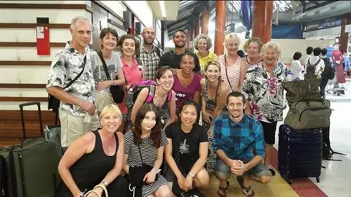
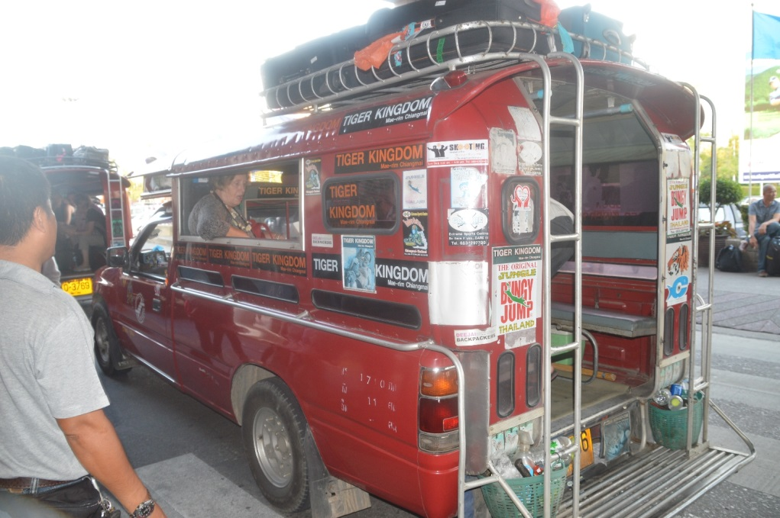
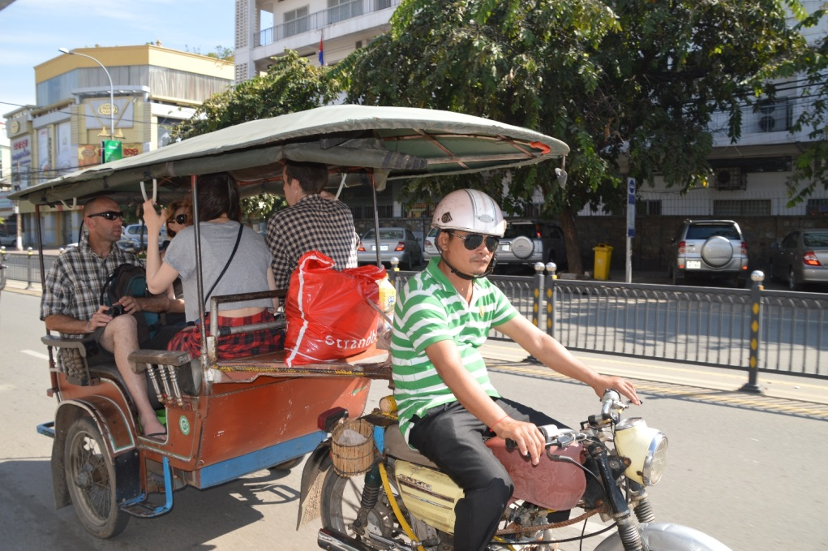
Team & Transport
Notes:
Team & Transport

Slide 9
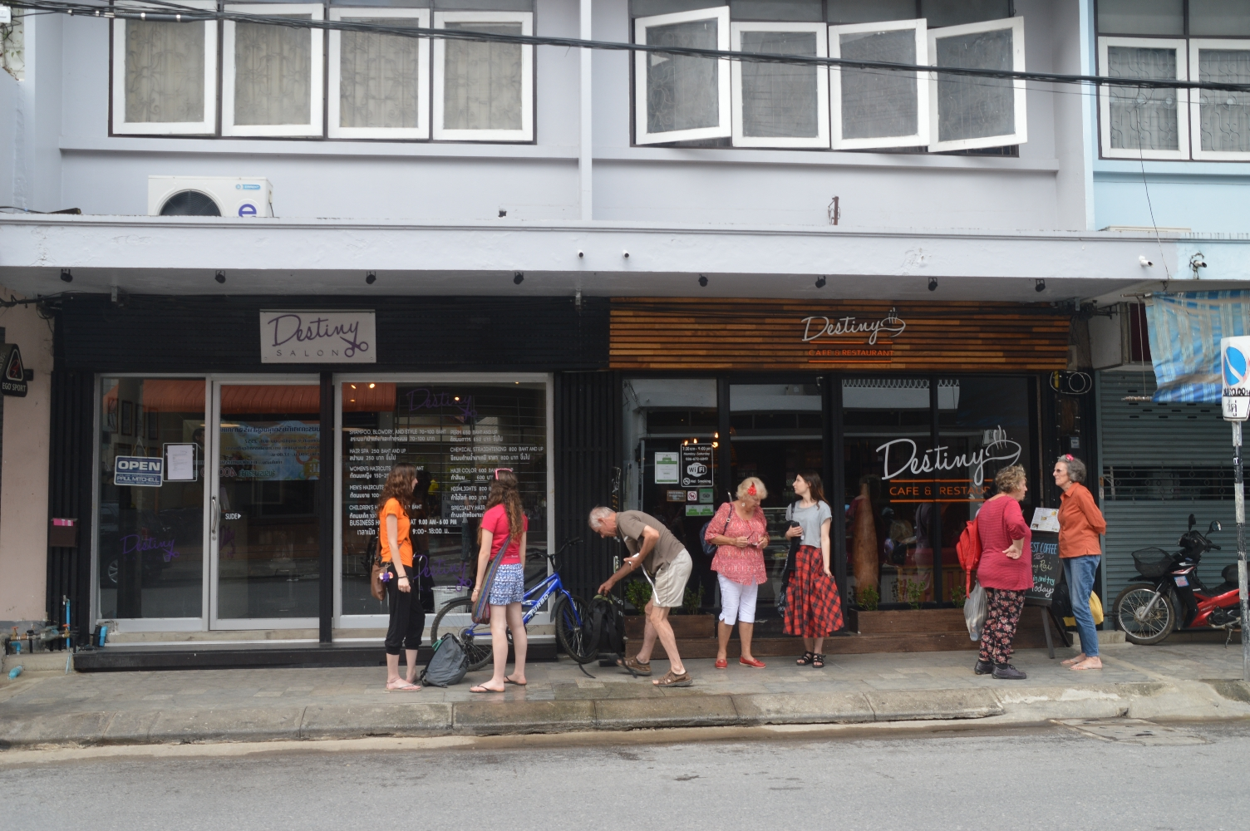
Hairdressing Salon & Cafe
Notes:
Hairdressing Salon & Cafe

Slide 10
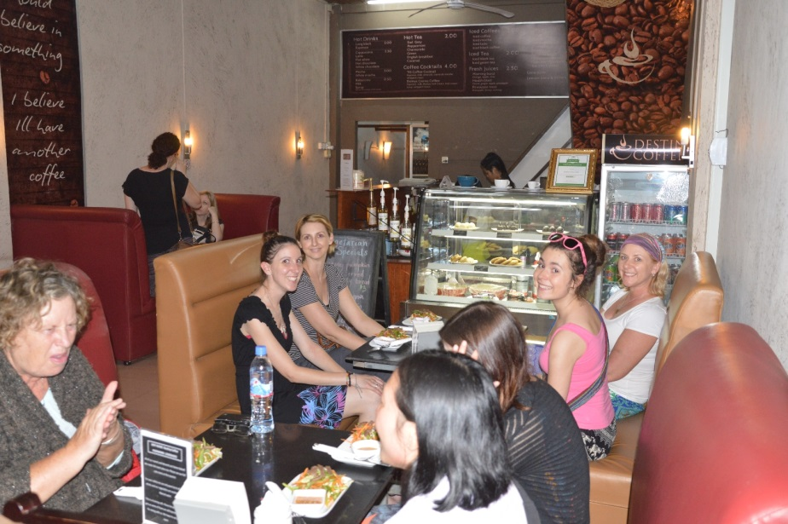
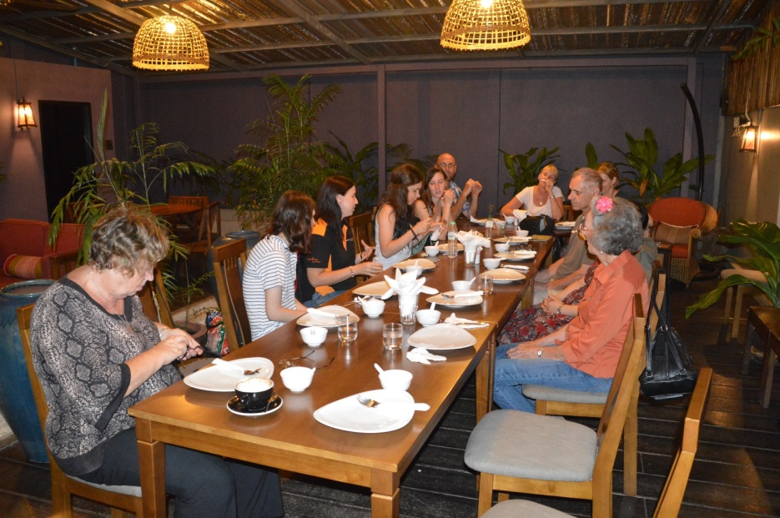
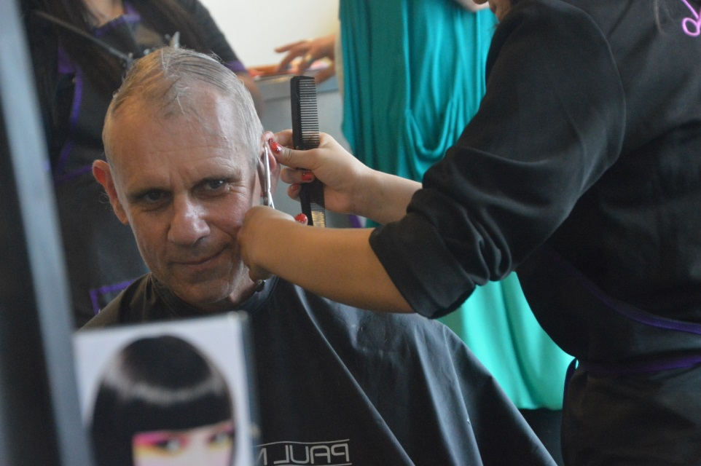
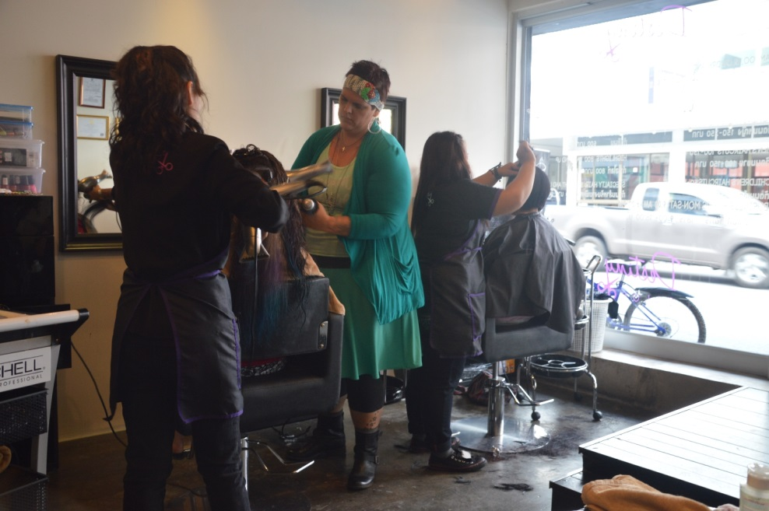
Inside the Café & Hairdresser
Notes:
Inside the Cafe

Slide 11
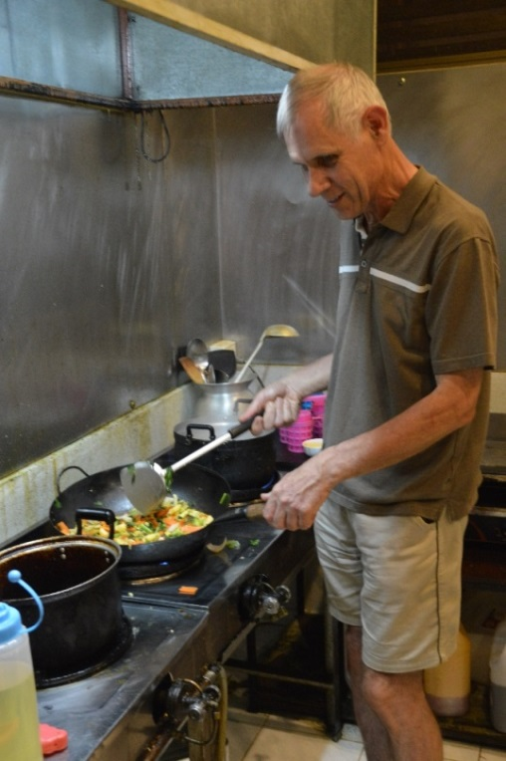
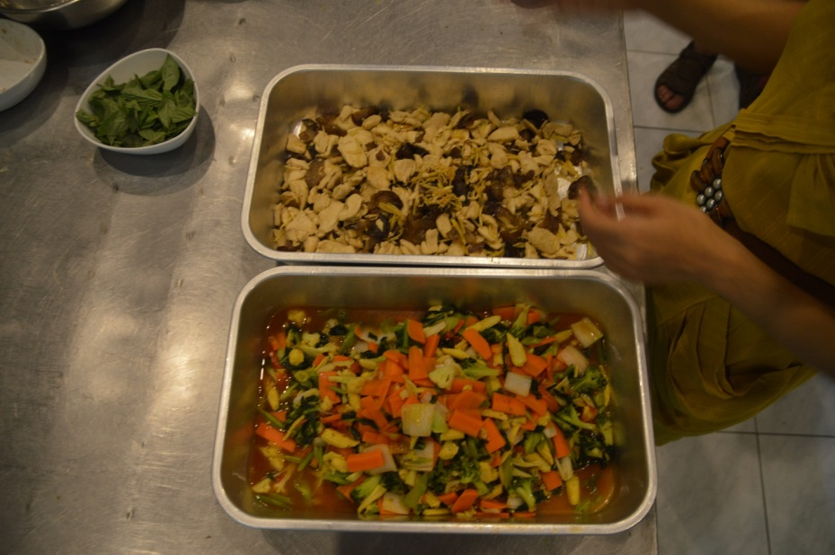
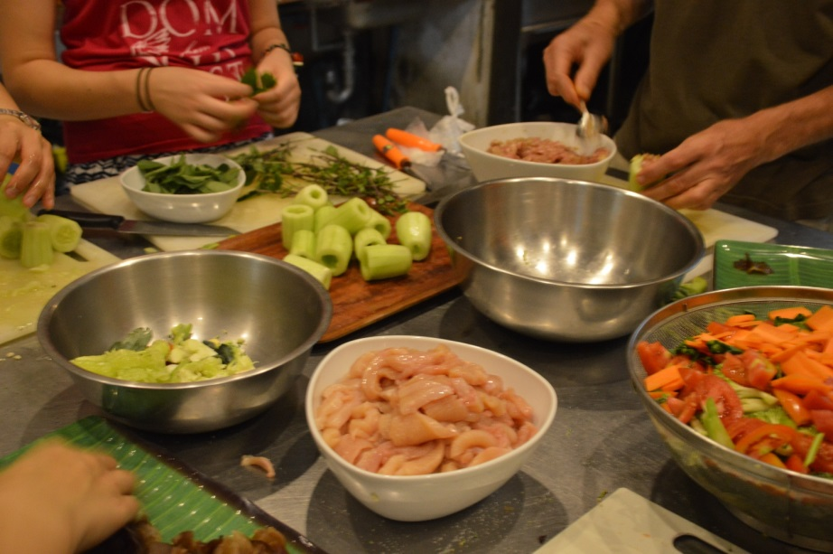
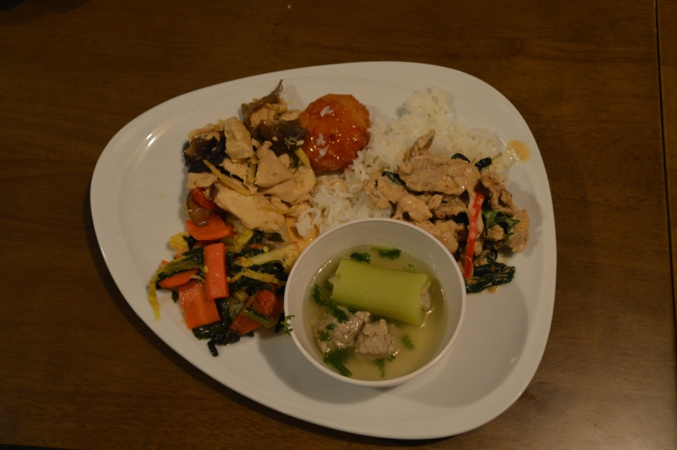
Cooking Classes
Notes:
Cooking Classes, Menu & Recipe

Slide 12
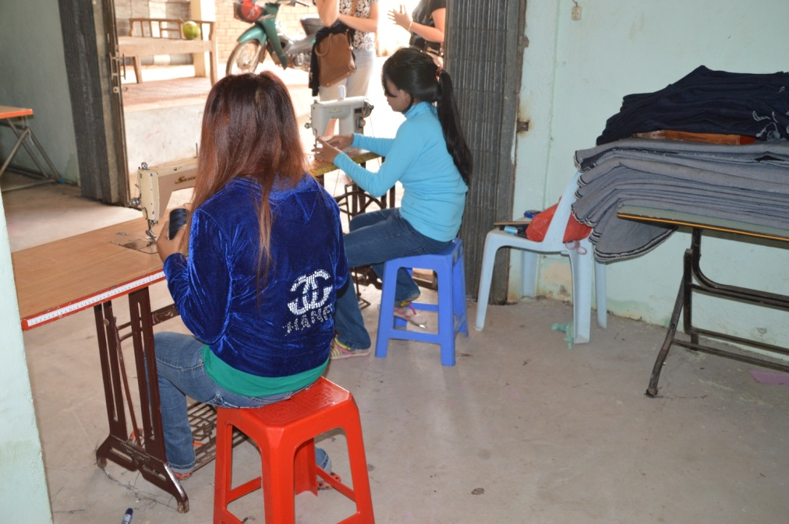
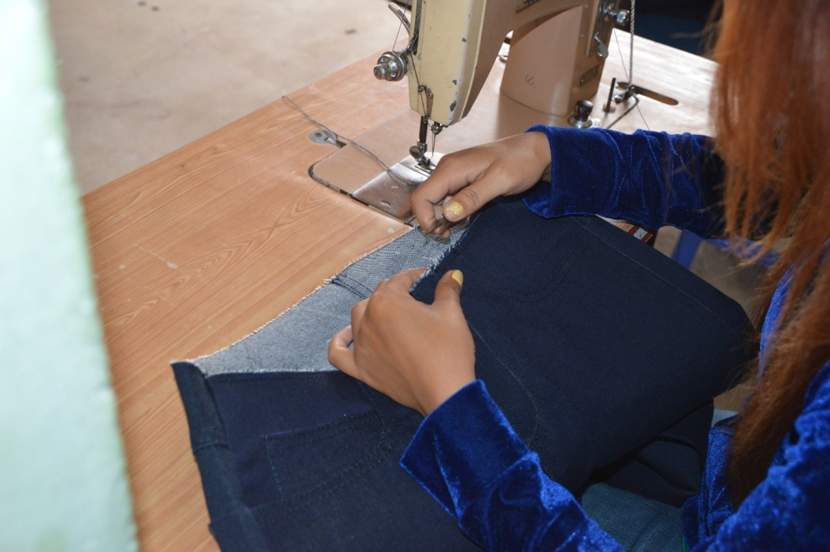
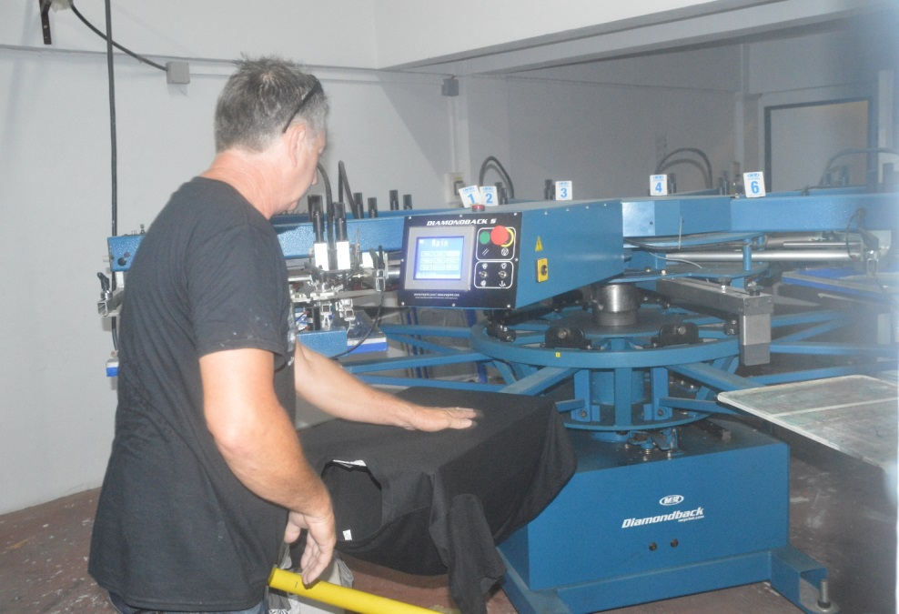
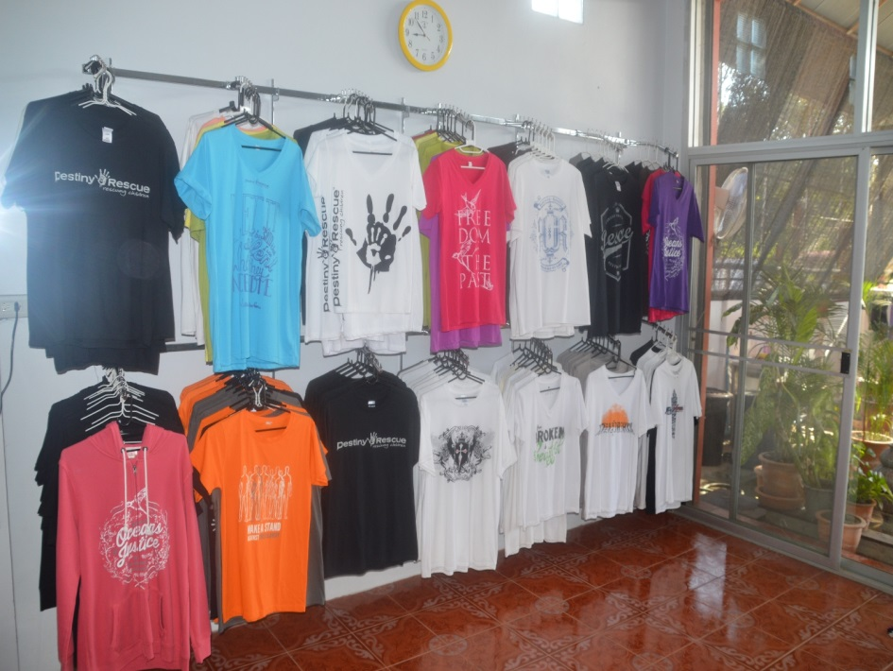
Jeans Making & T-Shirt Printing
Notes:
Jeans Factory

Slide 13
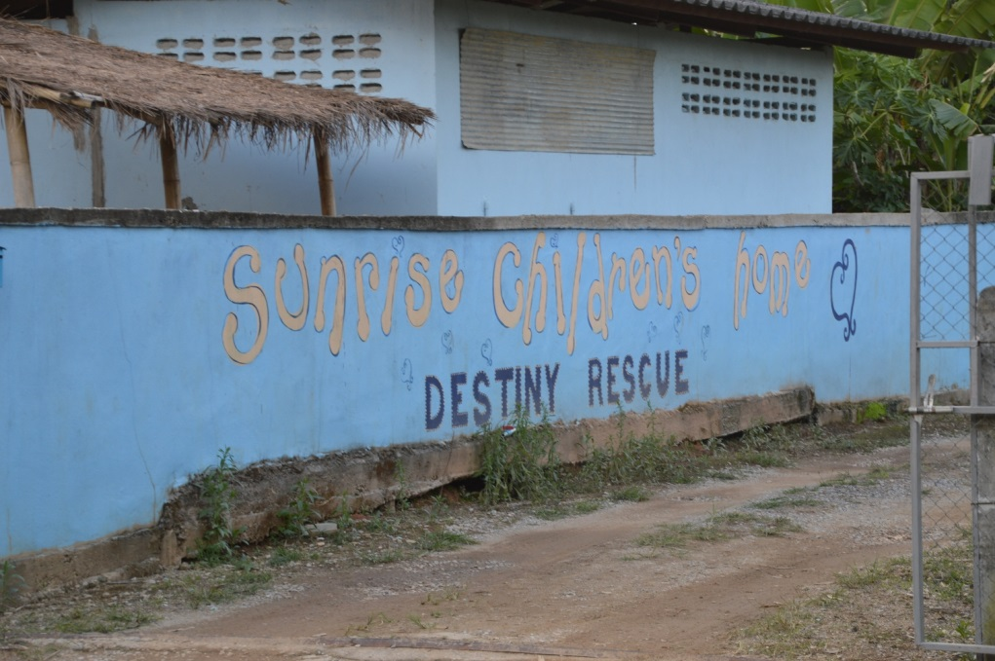
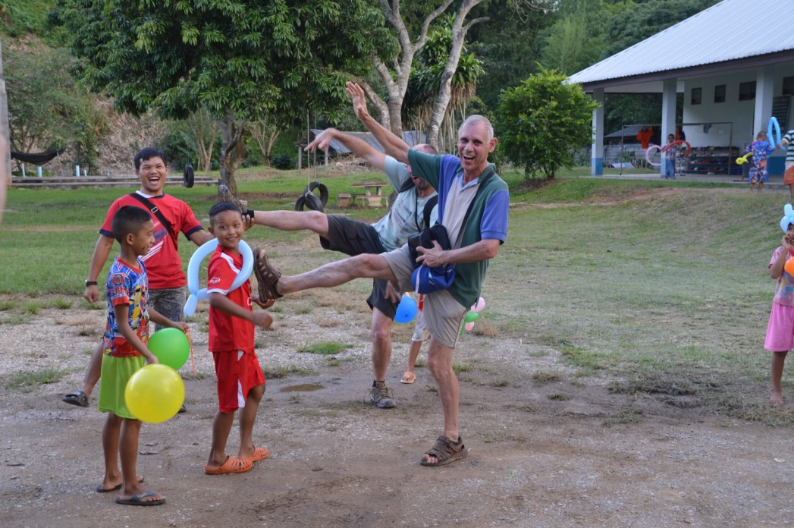
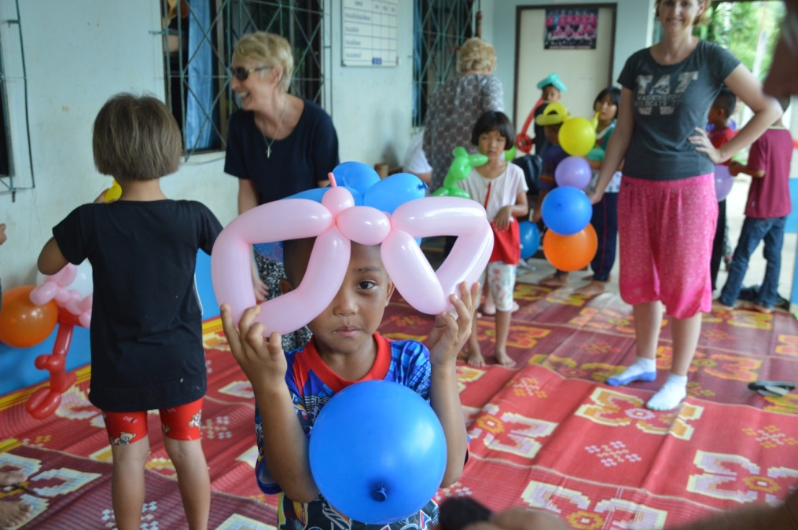
Sunrise Children's Home - Thailand
Notes:
Sunrise Children's Home

Slide 14
2015
Phlas Prei Centre
Notes:
2012
Phlas Prei Centre

Slide 15
Zimbabwe
2016
Good Shepherd Centre
Chinhoyi (100Km NE of Harare)
Notes:
2016

Slide 16
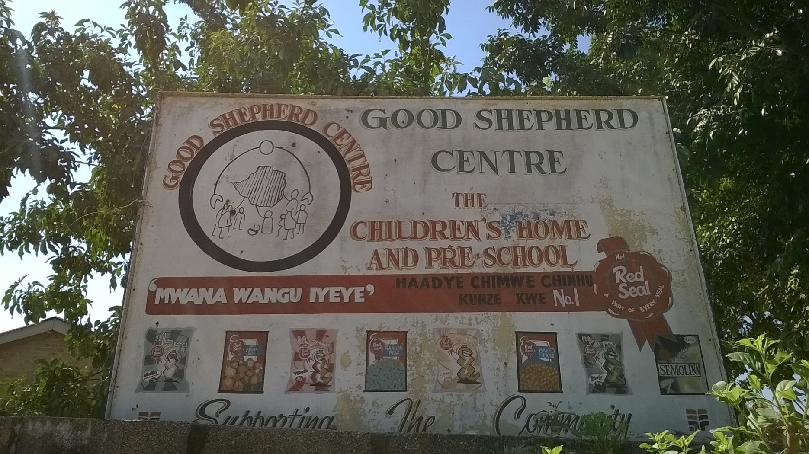
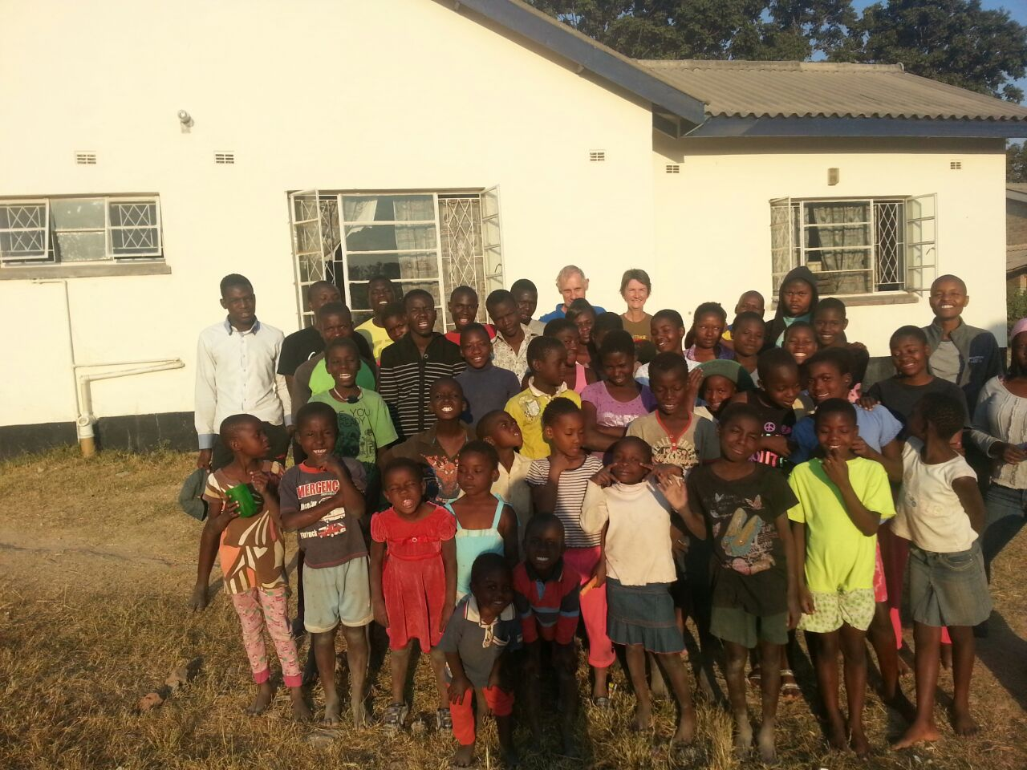
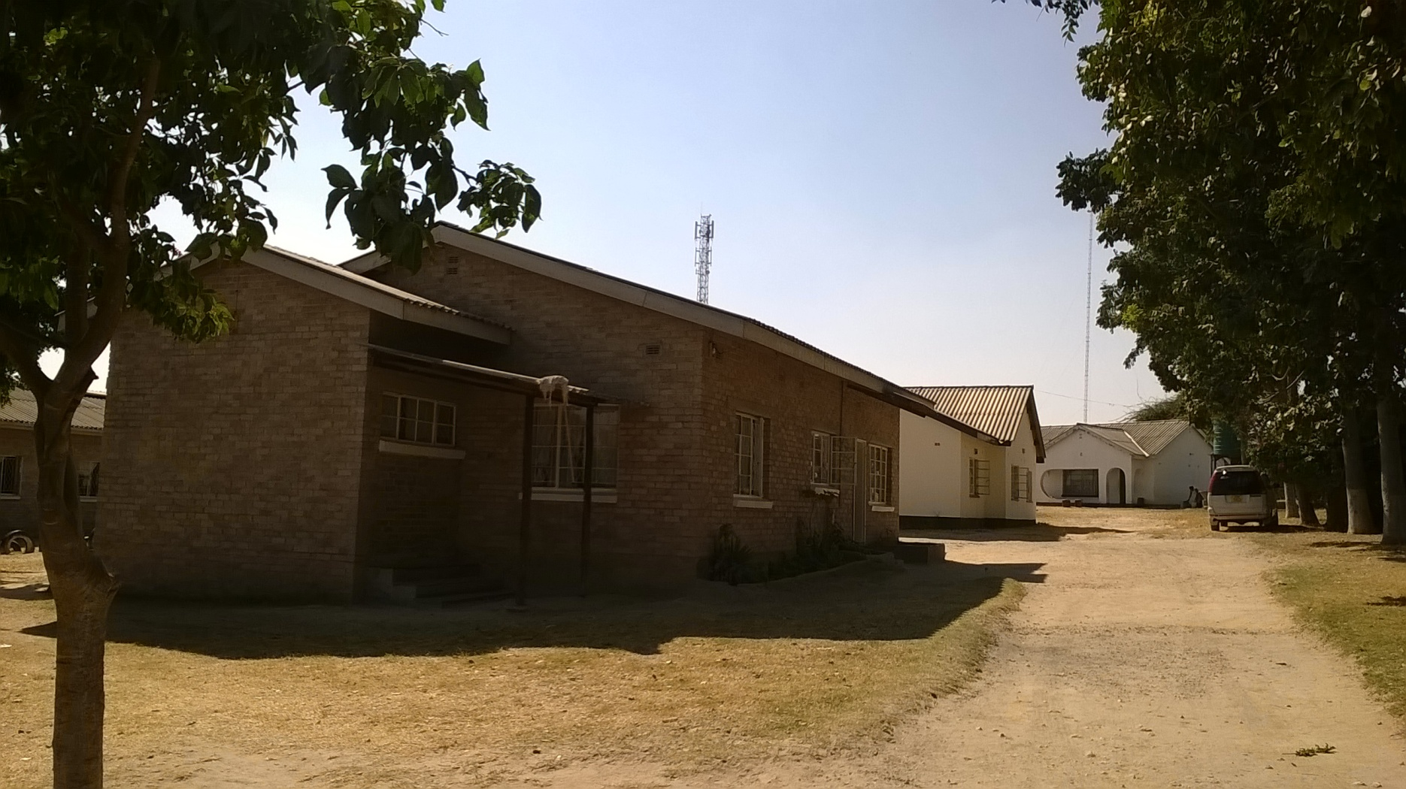
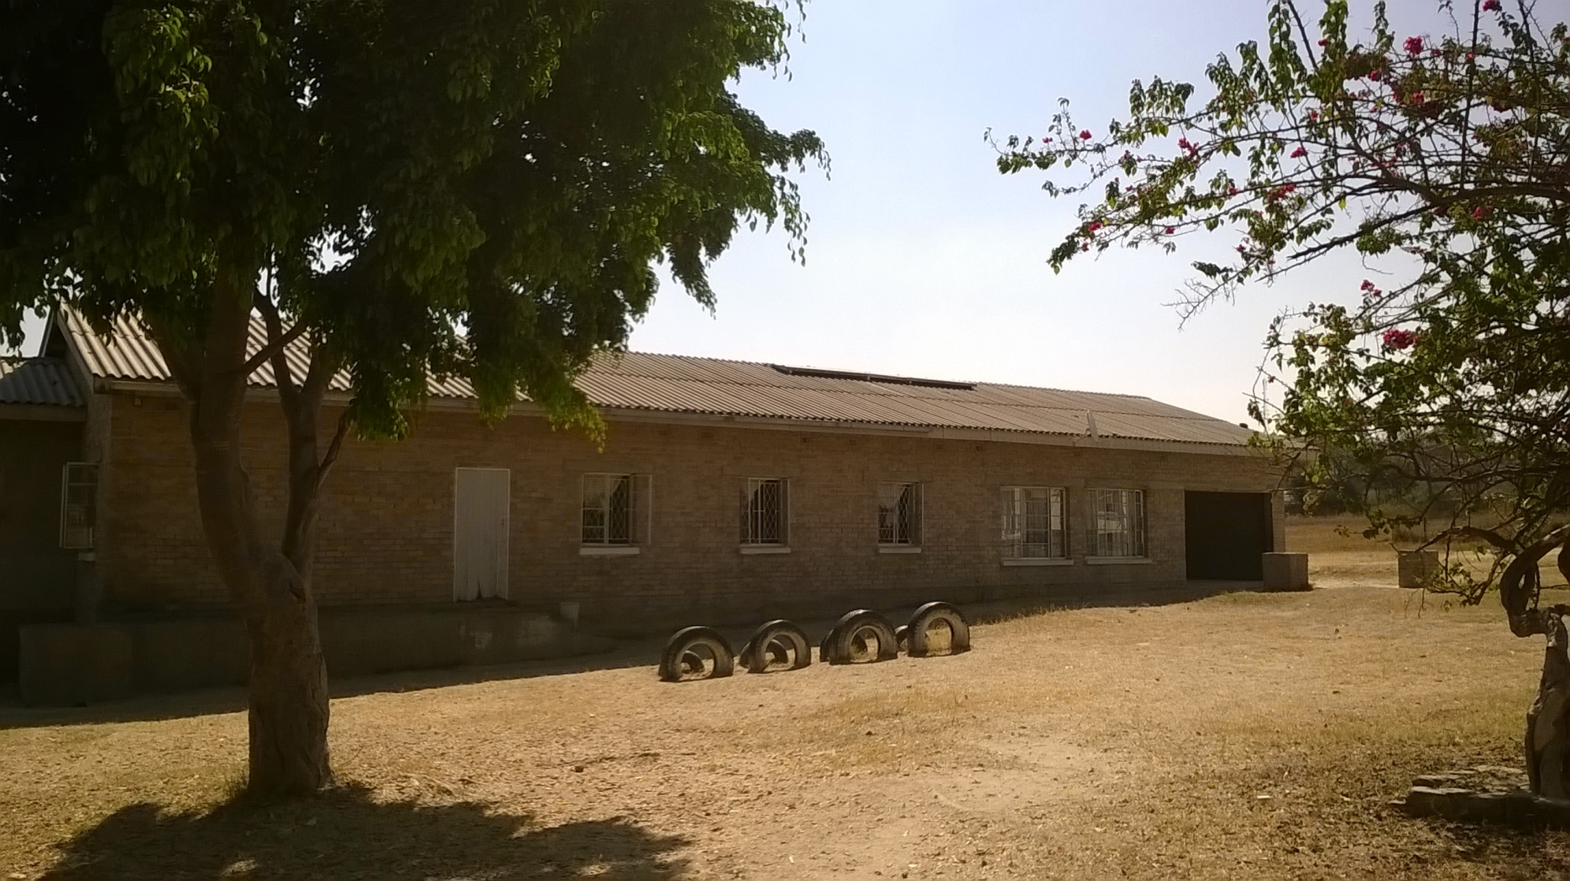
Good Shepherd Centre & Children
Notes:
Good Shepherd Centre & Children

Slide 17
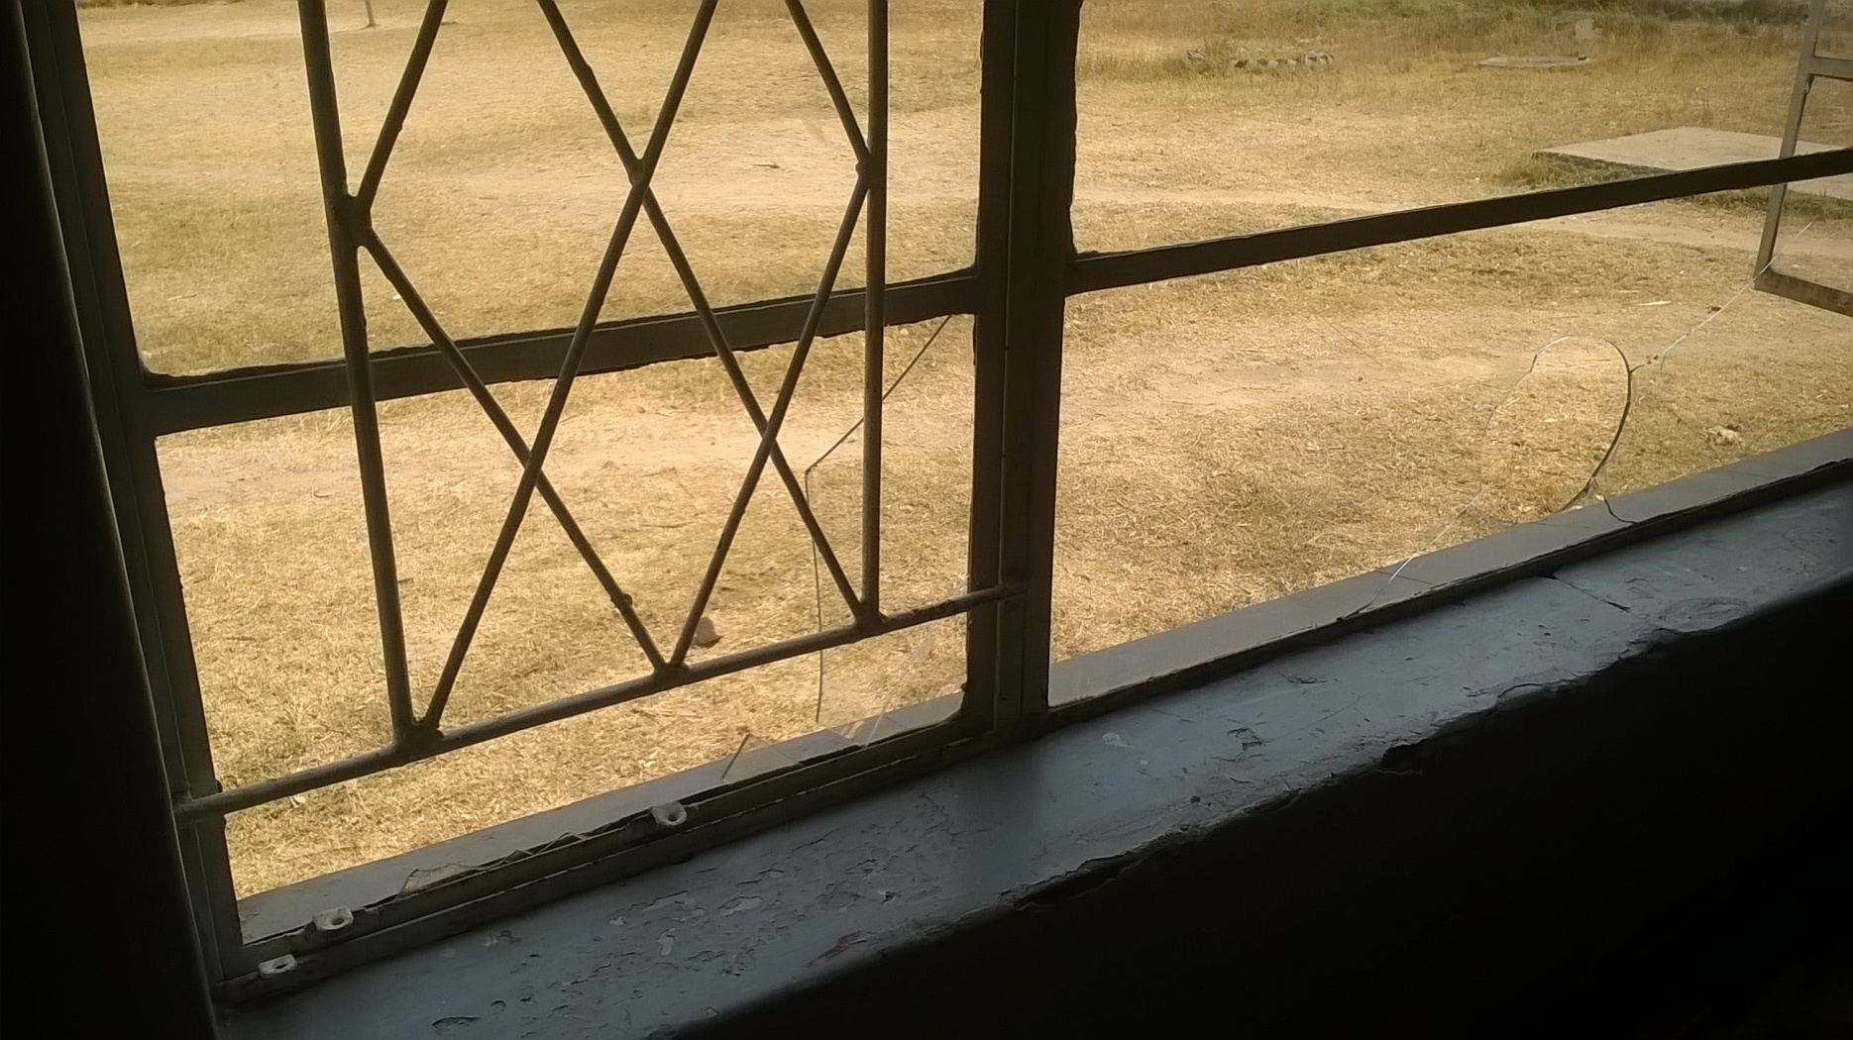
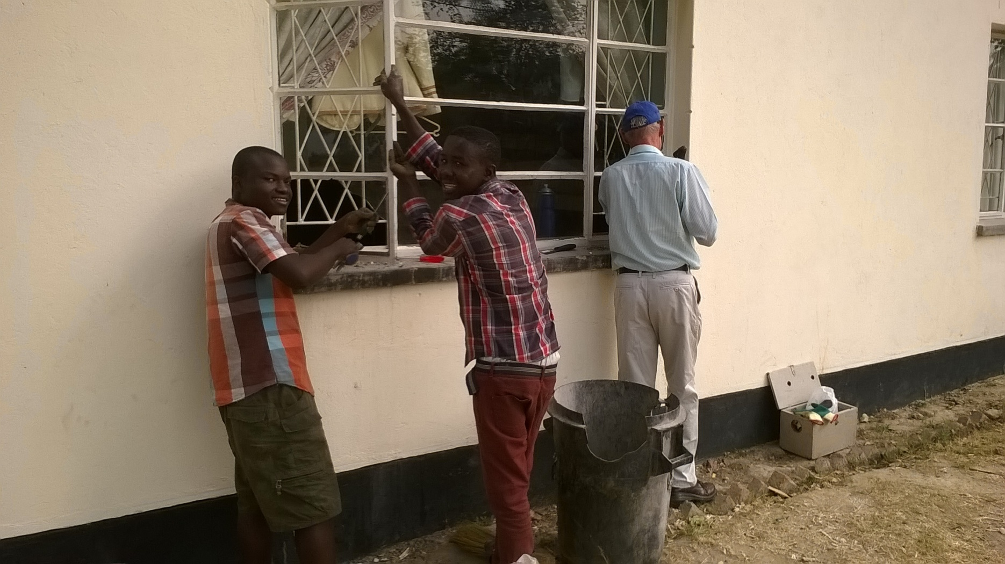
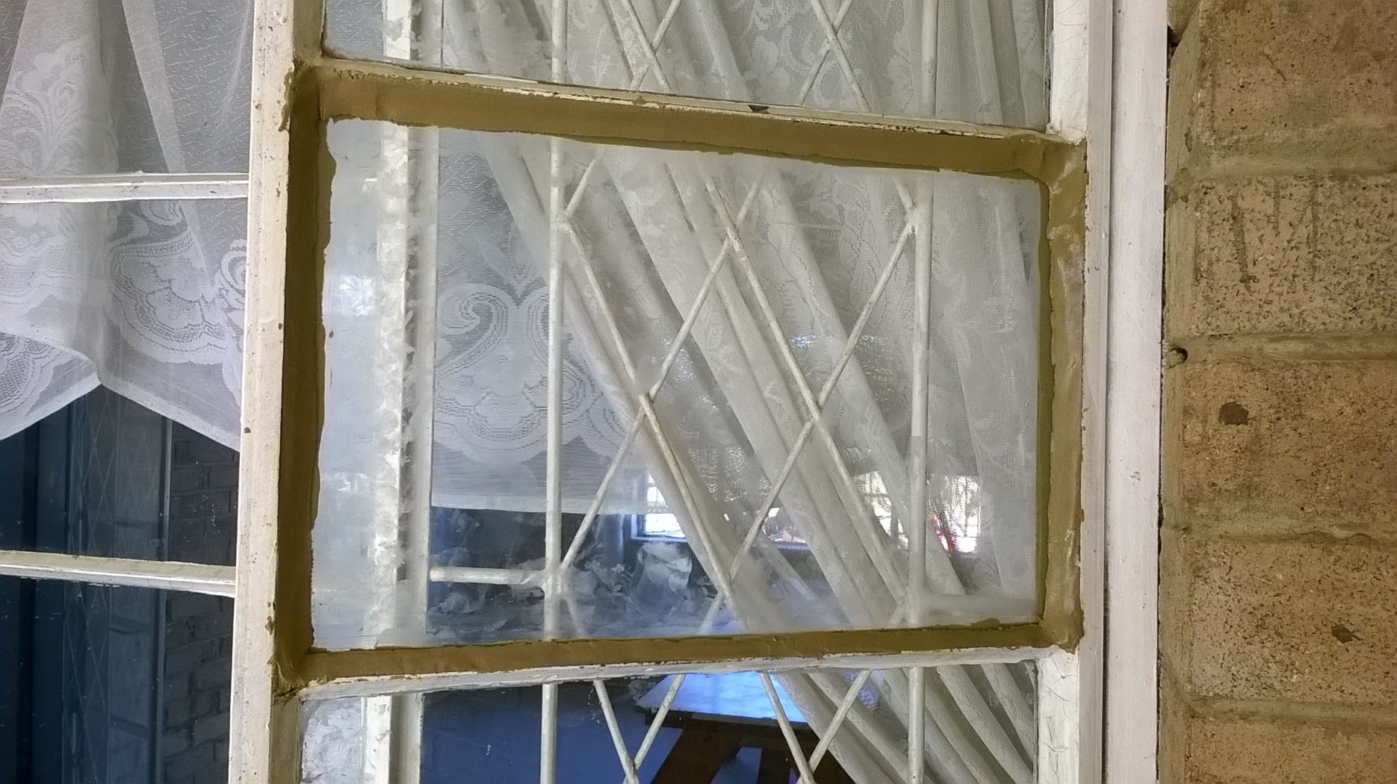
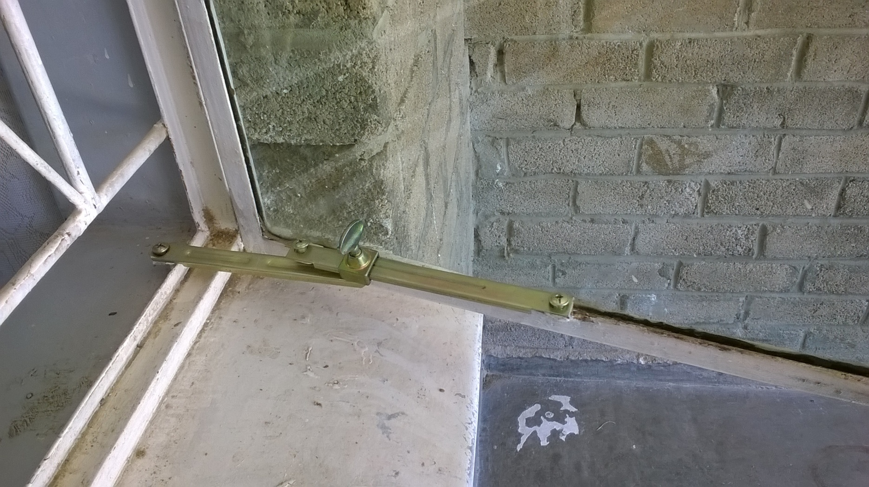
Repairing Broken Windows
Notes:
Repairing Broken Windows

Slide 18
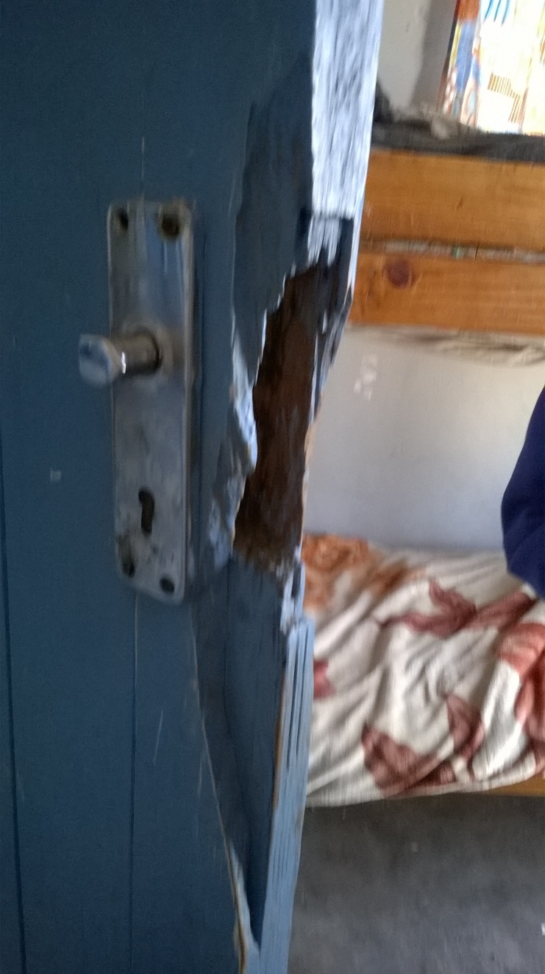
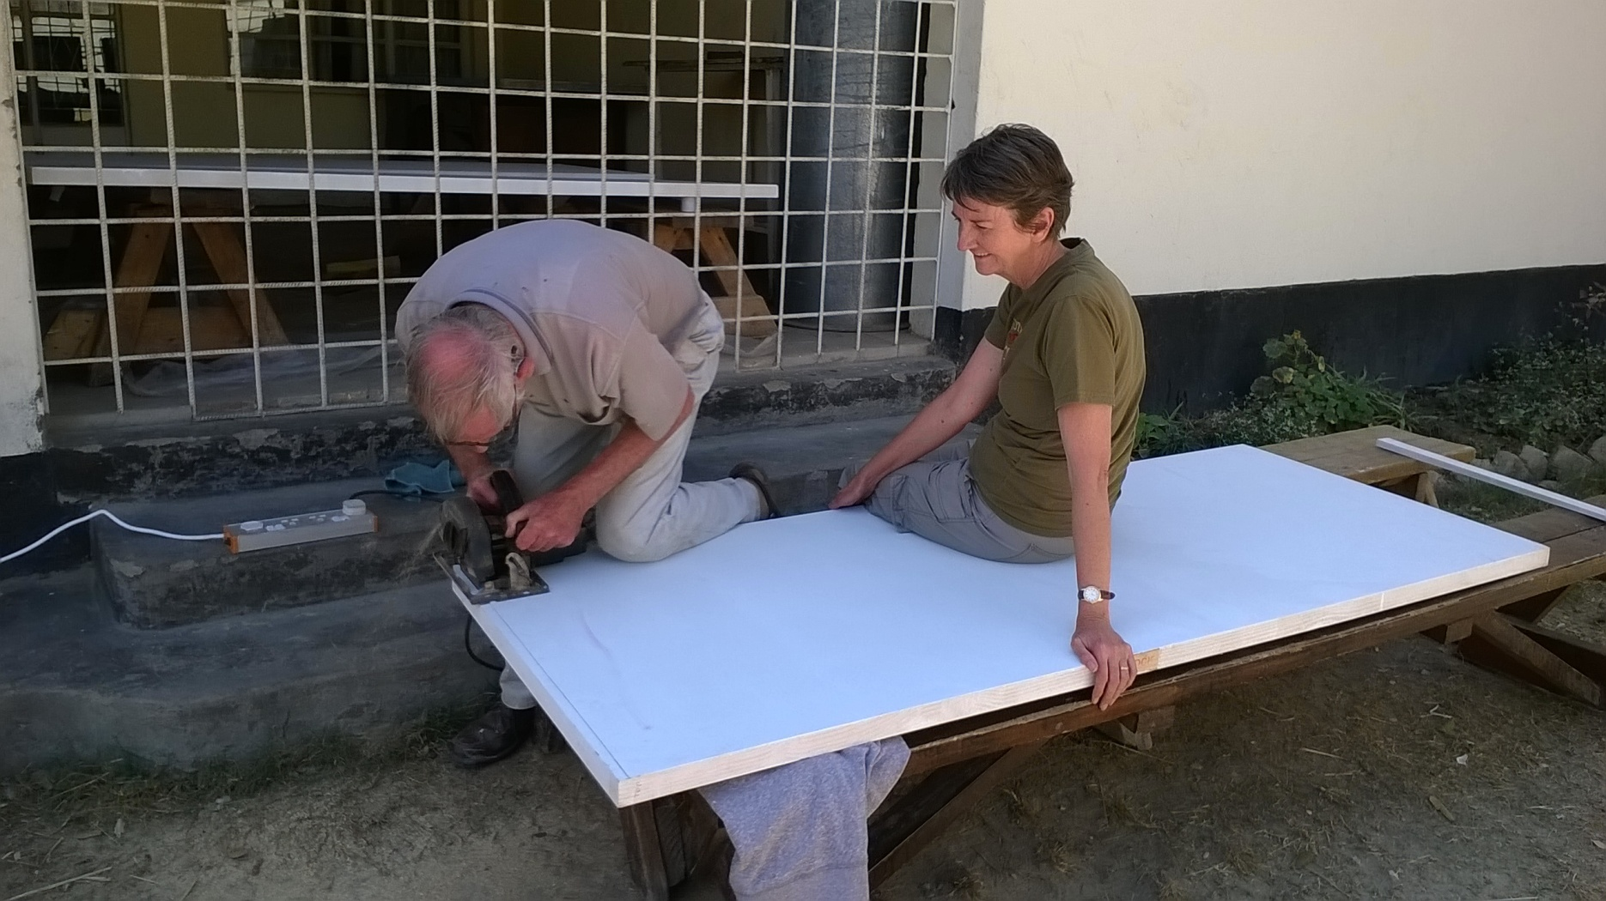
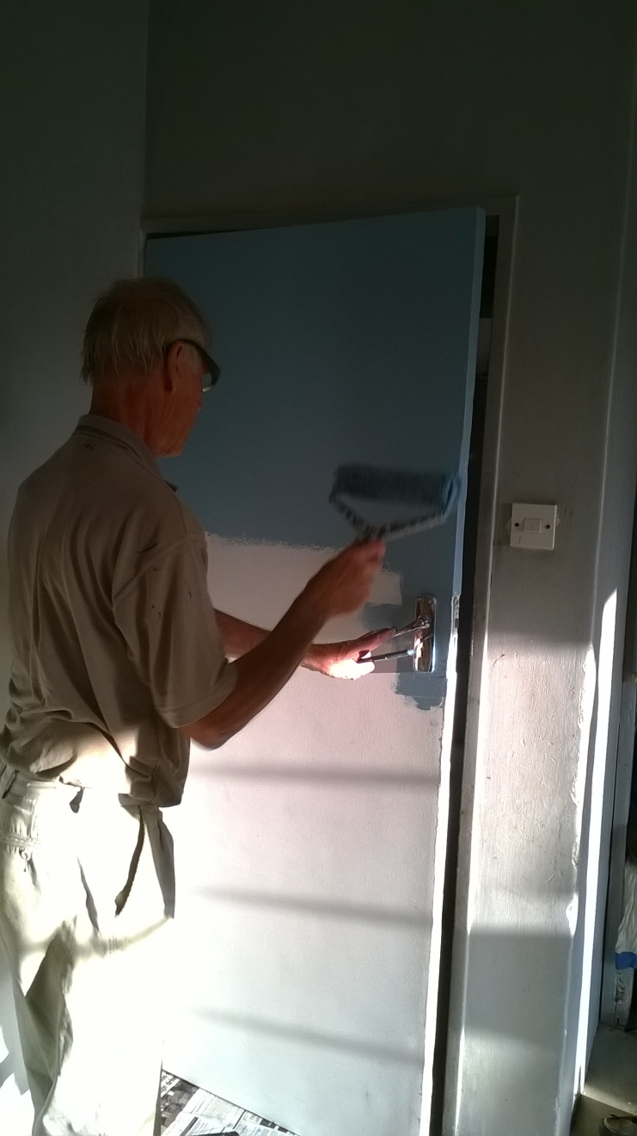
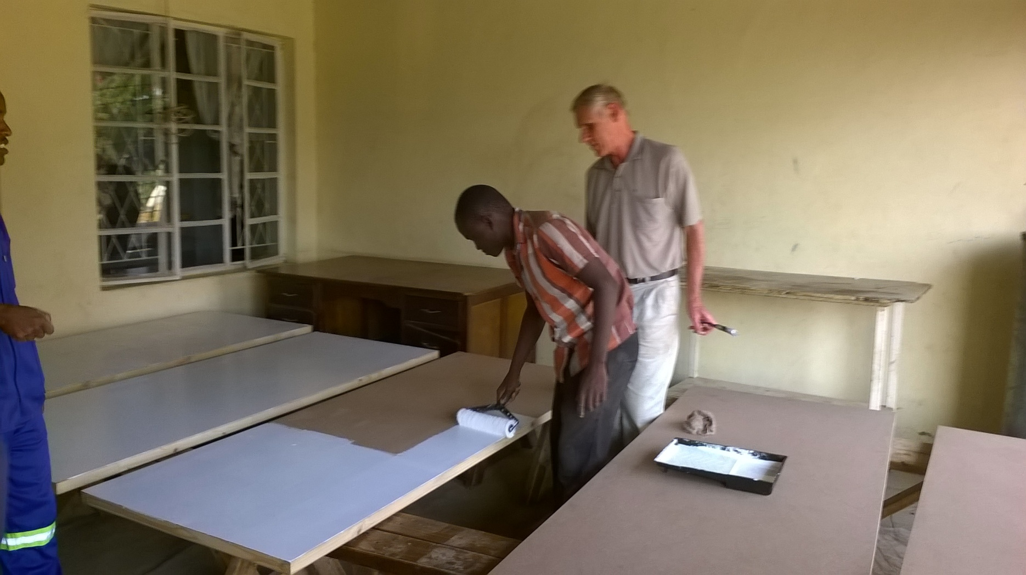
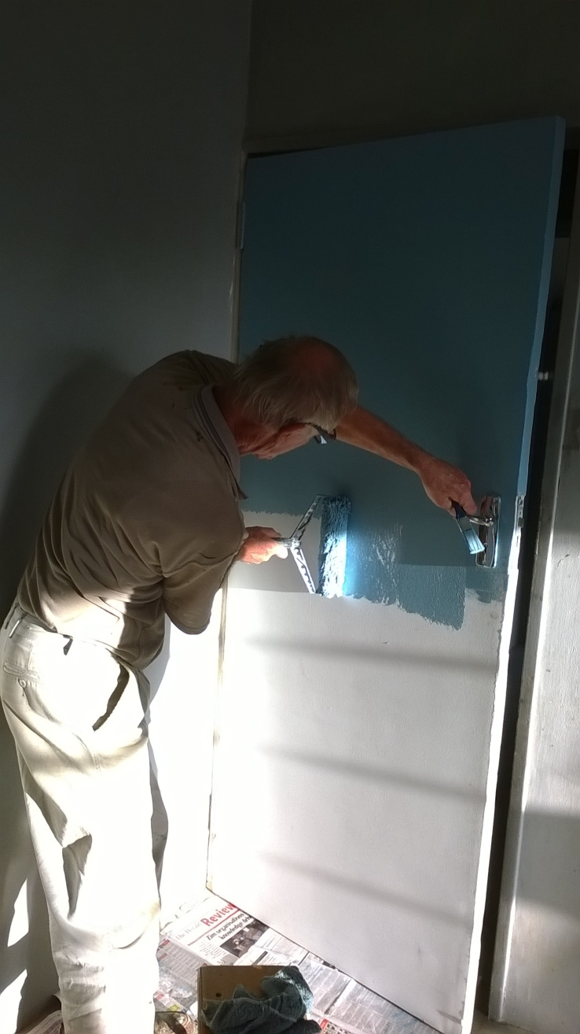
6 Internal Doors needed Replacing
Notes:
6 Doors needed Replacing

Slide 19
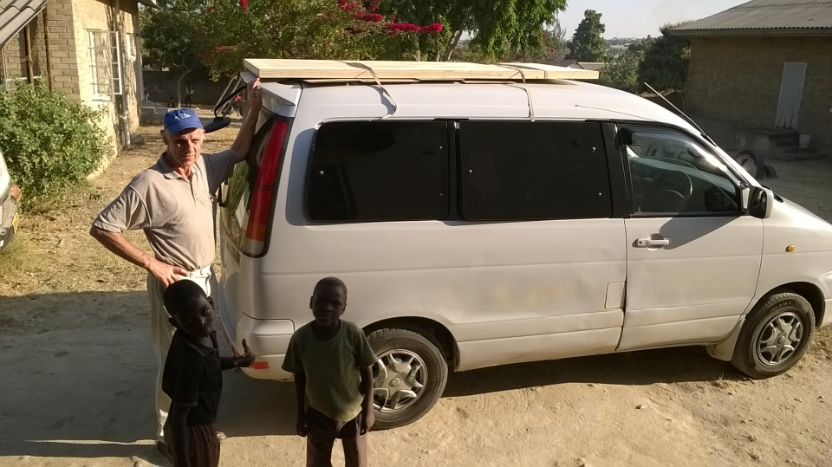
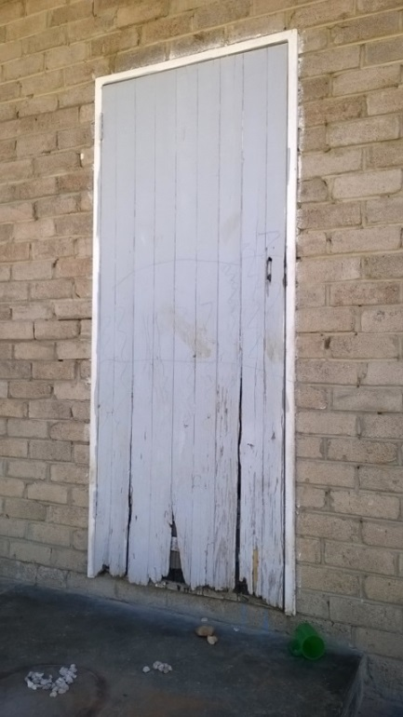
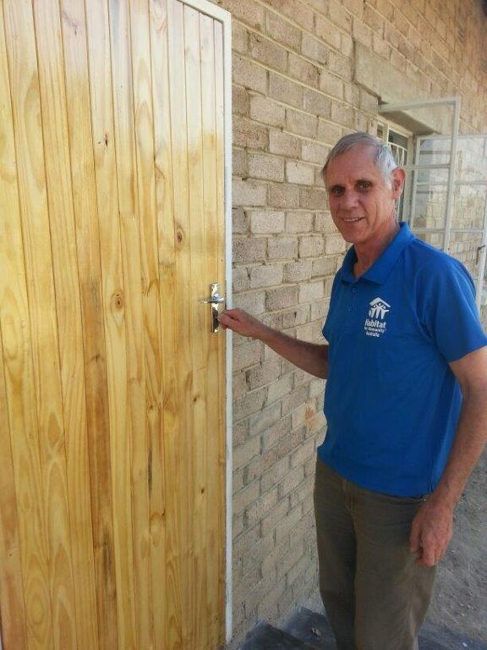
Replacing Outside Door of Girls Dorm
Notes:
Replacing Outside Door of Girls Dorm

Slide 20
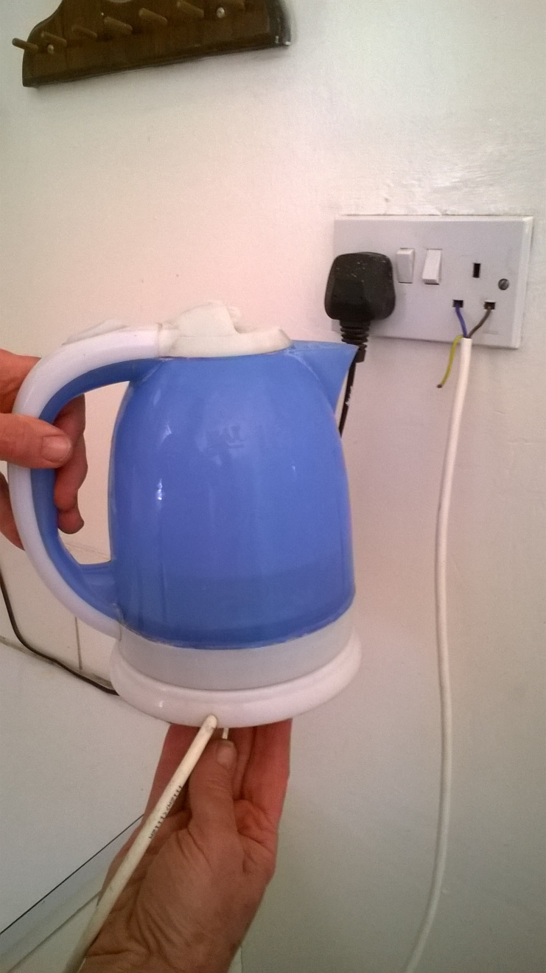
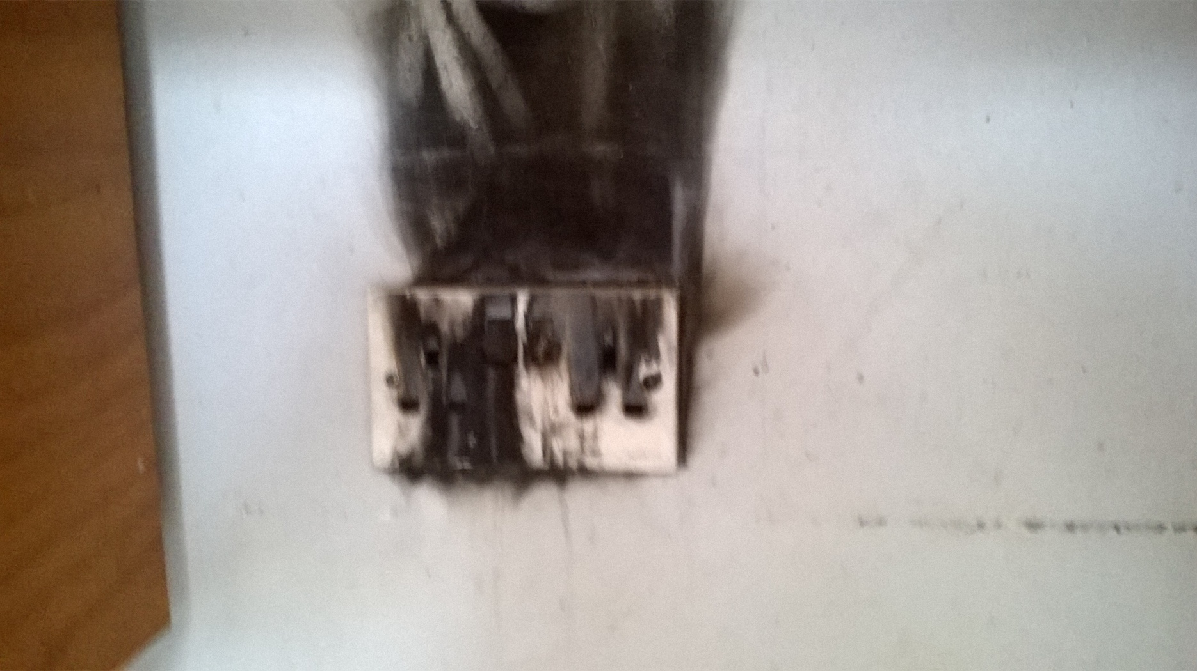
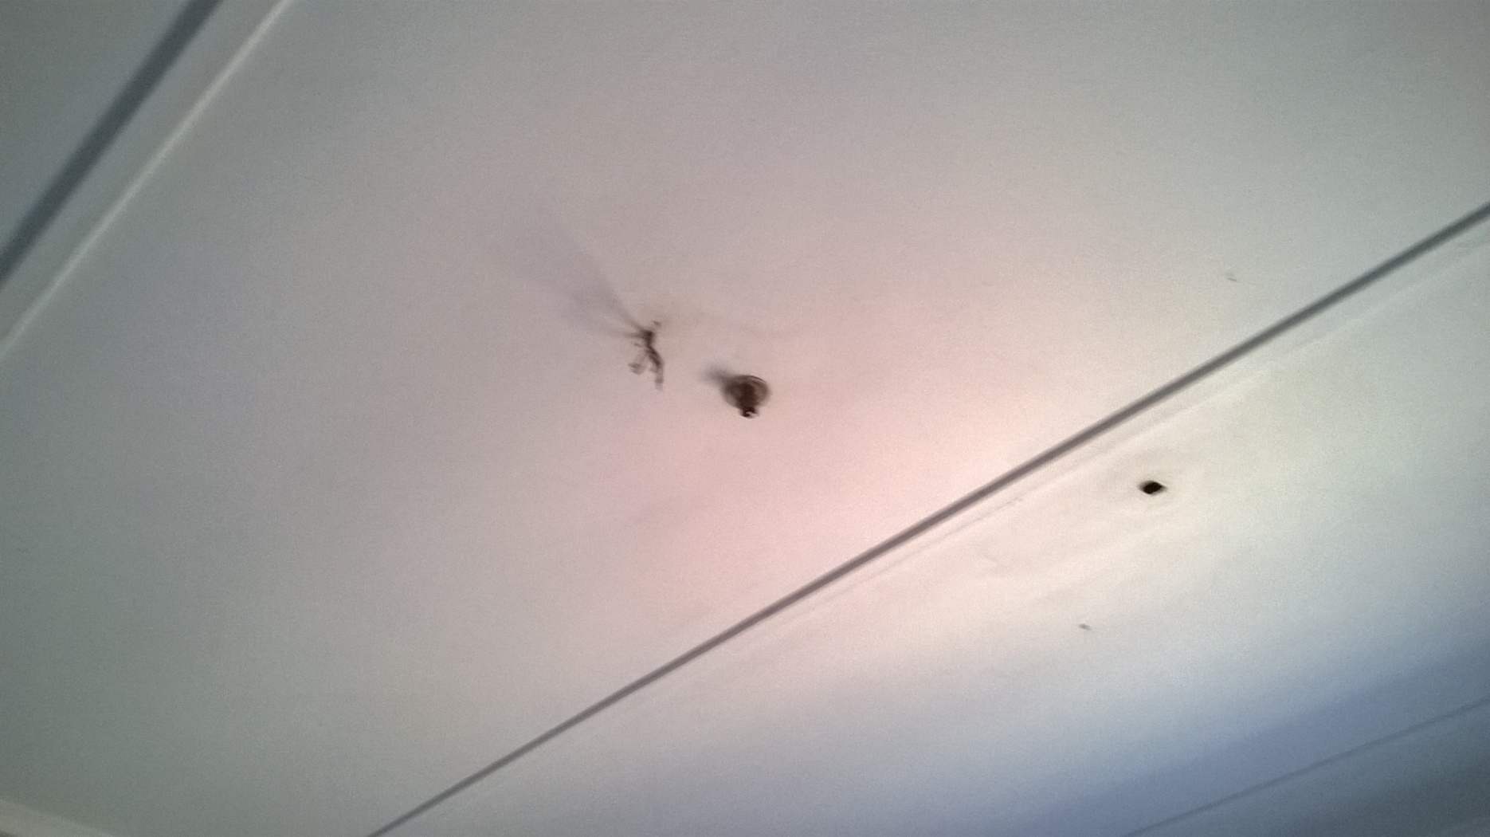
Electrical Work Required
Notes:
Electrical Work Required

Slide 21
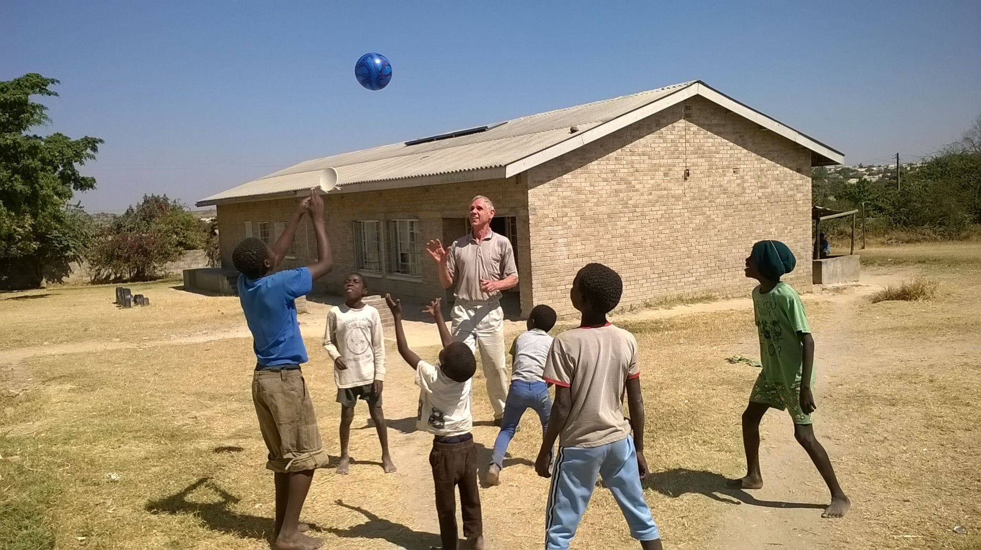
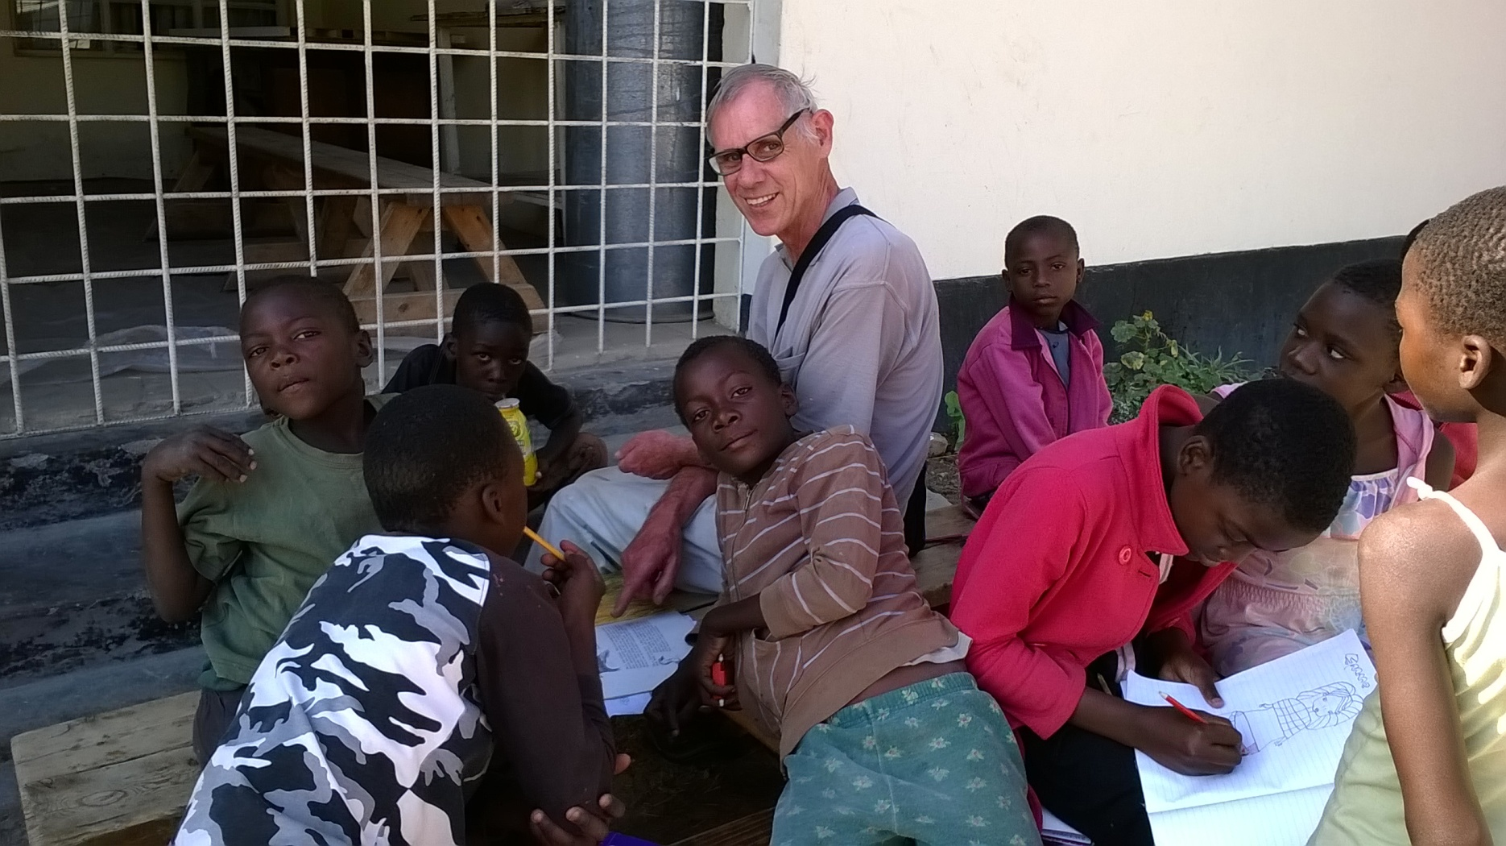
Interacting with Children & Our Helpers
Ruddy & Simba
Notes:
Interacting with Children & Awarding Certificates Ruddy & Simba

Slide 22
Technicians Volunteer Day
22 Sept 2016
Pinery Bushfire Recovery Project

Slide 23
25 Nov 2015 - Pinery Bushfire Area 85,000 Hectares, 91 Homes, 2 Lives

Slide 24
Wasleys Post Office
Wasleys Post Office
Property at back of PO
Notes:
Property at back of PO Wasleys Post Office

Slide 25
The Unisa Technicians Team
Notes:
The Unisa Technicians Team

Slide 26
Wasleys Property
Notes:
Work in Progress

Slide 27
Work in Progress
Notes:
Work in Progress

Slide 28
Questions
During this Time Photos of Safari Animals in Kenya & Tanzania will be showing
Notes:
During this Time Photos of Safari Animals in Kenya & Tanzania will be showing

